Slide 1
Exercise problems for students taking the Programming Parallel Computers course.
Janusz Kowalik
Tadeusz Puzniakowski
Informatics Institute
Gdansk University
October 7-25,2013

Slide 2
General comments
For all problems students should develop and run sequential programs for one processor and test specific numeric cases for comparison with their parallel code results.
Estimate speedups and efficiencies.
.
Problems 1-6 C/MPI
Problems 7-9 C/OpenMP

Slide 3
Problem 1.Version 1.
Design and implement an MPI/C program for the matrix/vector product.
1. Given are : a cluster consisting of p=4 networked processors,
a square n=16, (16 x 16) matrix called A and a vector x.
2.Write a sequential code for matrix/vector product.
Generate some matrix and a vector with integer components
3. Initially A and x are located on process 0.
4. Divide A into 4 row-strips each with 4 rows.
5. Move x and one strip to process 1,2 and 3.
6. Let each process compute a part of the product vector y.
7. Assemble the product vector on process 0 and
let process 0 print the final result vector y.
…………………………

Slide 4


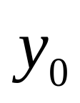





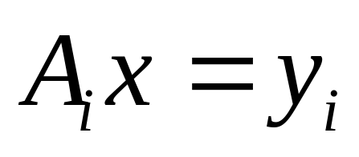

Parallel matrix/vector multiply.
Partitioning the problem Ax=y
x
=
Each strip of A has 4 rows
Each process calculates a part ( four elements ) of y.

Slide 5
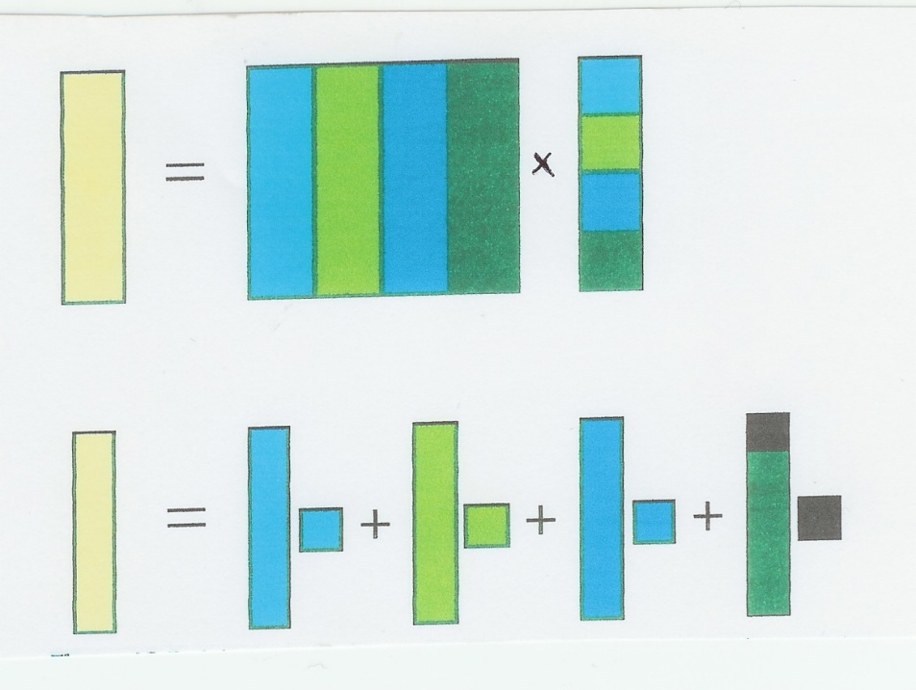
Matrix/vector product
Version 2.
Make Matrix A and vector x available to all processes as global variables.
Each process calculates a partial product by multiplying one column of A by an element of x. Process 0 will add the partial results.
y
A
x

Slide 6
Matrix-vector product
Write two different programs
and check results for the same data.
Increase the matrix and vector size to n= 400 and compare the parallel compute times.
Which version is faster?
Why?

Slide 7

Comment on a Fortran alternative
Matrix vector product using Fortran
In Fortran two
dimensional
matrices are stored
In memory by columns .
We would prefer
decomposing the matrix
by columns
and having each process
to produce a column strip
as shown on this slide.
This algorithm is different from the algorithm Version 1 used for C++.
In the C++ version 1 we could use dot products.

Slide 8
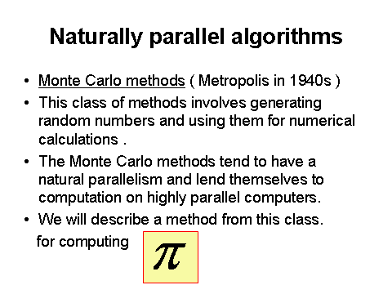
Problem 2.

Slide 9

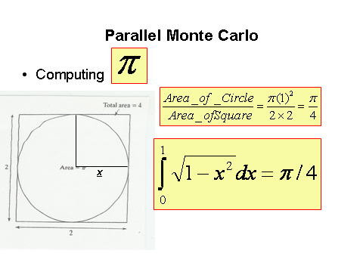

Parallel Monte Carlo method for calculating

Slide 10


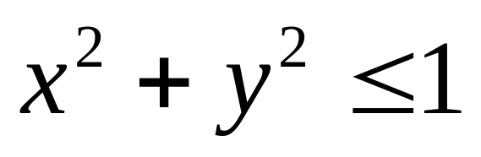


Monte Carlo computation of
r=1
Counting pairs
of random numbers
x,y that satisfy inequality
yes
no
=

Slide 11
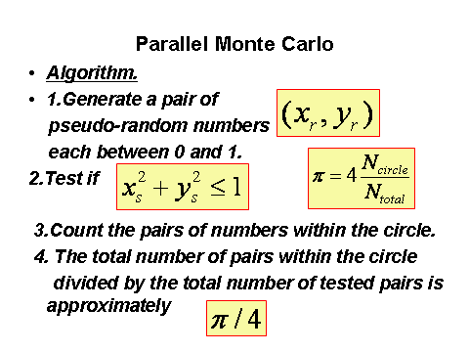
Monte Carlo algorithm

Slide 12
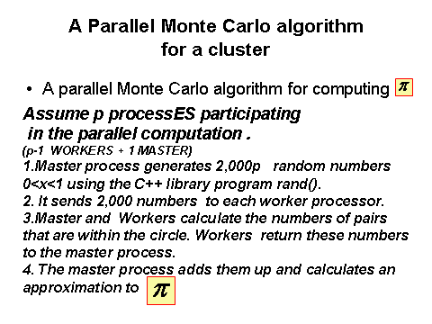

Slide 13

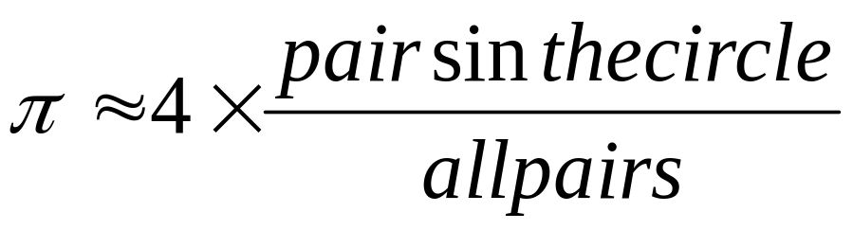
The task.
Implement the following parallel algorithm.
Parallel algorithm.
1.Process 0 generates 2,000 p random
uniformly distributed numbers between 0 and 1,
where p is the number of processors in the cluster.
2. It sends 2,000 numbers to processes 1, 2 … p-1.
3. Every process checks pairs of numbers and counts the pairs satisfying the test.
4. This count is sent to process 0 for computing the sum and calculating an approximation
to

Slide 14
Comments.
For generating random numbers use the library program available in C or C++.
Before writing a MPI/C++ parallel code
write and test a sequential code.
All processes execute the same code for different data .This is called the Single Program Multiple Data; SPMD.

Slide 15
Continued
Another version is also possible.
One process is dedicated to generating random numbers and sending them one by one to other worker processes.
Worker processes check each pair and accumulate their results. After checking all pairs the master process gets the partial results by using MPI_Reduce.
It calculates the final approximation .
This version suffers from large number of communications.

Slide 16
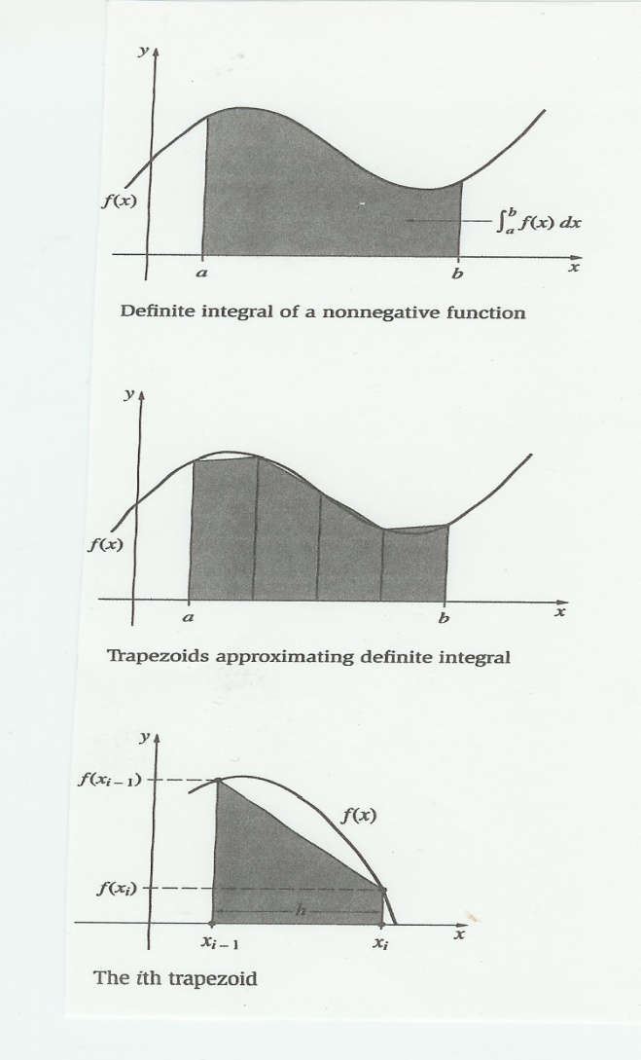
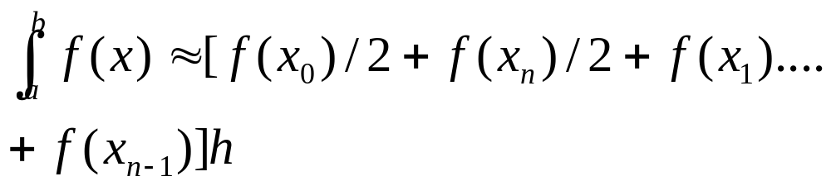
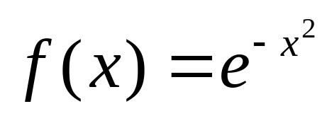
Problem 3.
Definite integral of a one dimensional function.
Input: a,b, f(x)
Output the integral value.
The method used is the trapezoidal rule.
Implement this parallel algorithm for: a=-2,
b=2 and n=512

Slide 17
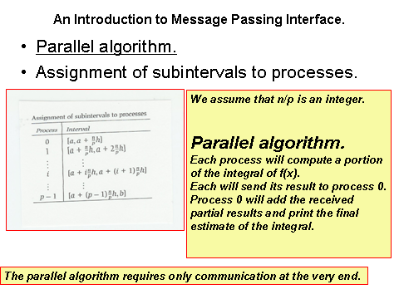
Parallel integration program.

Slide 18
Comments.
The final collection of partial results should be done using MPI_Reduce.
Assuming that we have p processes the subintervals are:
0 [a, a+(n/p)h]
1 [a+(n/p)h, a + 2(n/p)h]
………………………………..
p-1 [a+(p-1)(n/p)h, b]

Slide 19
Comments
In your program every process computes its local integration interval by using its rank.
Make variables a, b, n available to all processes. They are global variables.
All processes use the simple trapezoidal rule for computing approximate integral.

Slide 20
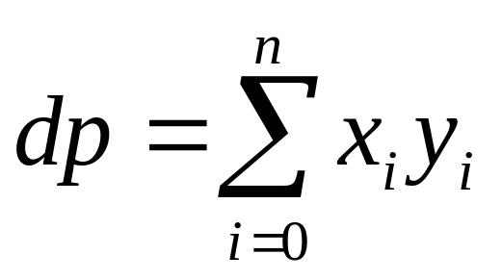
Problem 4.
Dot product
Definition.
Two vectors x and y
are of the same size.
Two vec,,,,,,,,,,,,,,,,,tors have the sa,
1.Write a sequential program for computing dot product
2.Assume n=1,000
3. Generate two vectors x and y and test the sequential program.

Slide 21

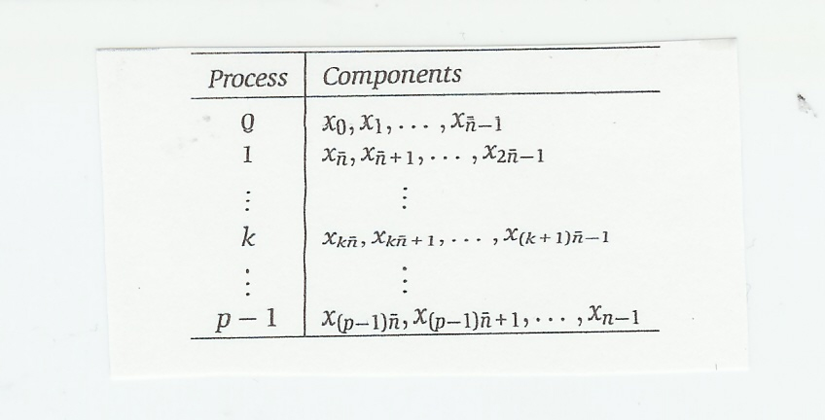
Dot product
Parallel program.
1. Given the number of processes p
the vectors x and y are divided into p
parts each containing components.
2. Block mapping of the vector x to processes is below:

Slide 22
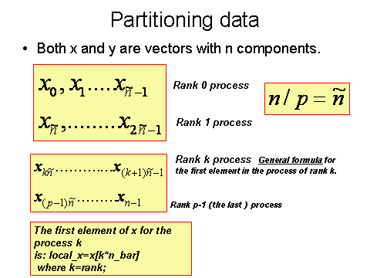

Slide 23
Dot product
3. Use your sequential program for computing parts of dot product in the parallel program.
4. Use MPI_Reduce to sum up all partial results. Assume the root process 0.
5. Print the result.

Slide 24
Dot product
The initial location of x and y is process 0.
Send both vectors to all other processes.
Each process ( including 0) will calculate a partial dot product for different set of x and y indices.
In general process k starts with the index
kn/p and adds n/p xy multiples.
k = my_rank characterizes every process
and such value as kn/p is called local.
Every process has a different variable kn/p.
Variables that are the same for all processes are called global.

Slide 25
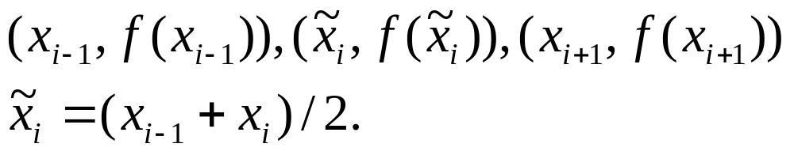
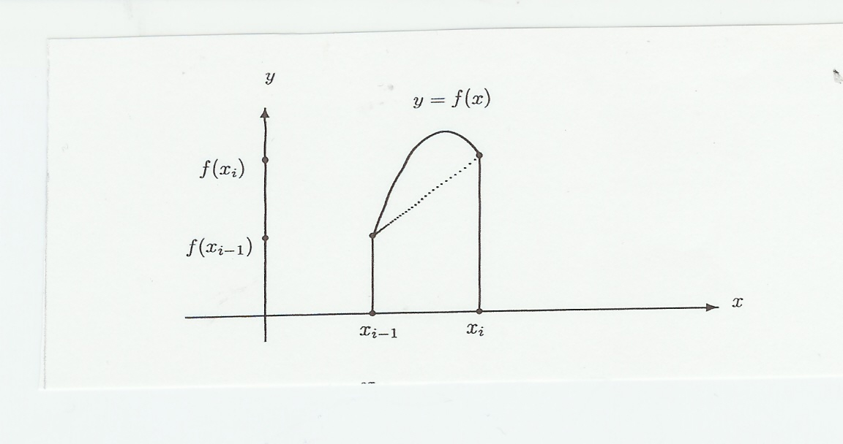
Problem 5.
Simpson’s rule for integration.
Simpson’s rule is similar to the trapezoidal rule but it is more accurate. To approximate the integral between two points it uses the midpoint and a second order curve passing through the three points of the subinterval. These points are:
Two points define
a trapezoid.
Three point define
a parabola

Slide 26
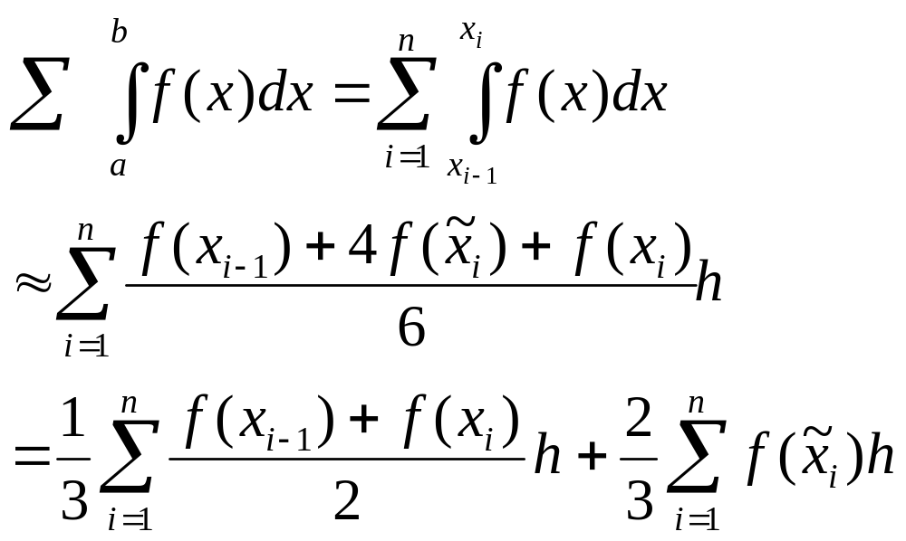
Problem 5.
Simpson’s rule for integration.
Notice similarity to
the trapezoidal rule.
Simpson’s rule is more accurate for many functions f(x)
but it requires more computation.

Slide 27

Simpson’s rule programming problem.
Write a sequential program implementing Simpson’s rule for integration.
Test it for: a=-2, b=2 ,n=1024 and
Then write a parallel C/MPI program for two processes running on two processors ; process 0 and process 1.
Make process 0 calculate the integral using the trapezoidal rule and process 1 using Simpson’s rule. Compare the results. How to show
experimentally that Simpson’s rule is more accurate?

Slide 28
Problem nr 6.
Design and run an C/MPI program for solving a set of linear algebraic equations using the Jacobi iterative method.
The test set should have at least 16 linear equations .
The communicator should include at least four processors.
Choose or create equations with the dominant diagonal.
Your MPI code should use the MPI Barrier function
for synchronizing parallel computation..
.To verify the solution write and run a sequential code
for the same problem.
Attach full computational and communication complexity analysis.

Slide 29
Problem 7
Write a sequential C main program for multiplying square matrix A by a vector x
Insert OpenMP compiler directive for executing it in parallel
The matrix should be large enough so that each parallel thread has at least 10 loops to execute.
Parallelize the outer and then the inner loop.
Explain the run time difference.

Slide 30
Problem 8
Write a sequential C main program to compute a dot product of two large vectors
a and b. Assume that the size of a and b are divisible by the number of threads.
Write n OpenMP code to calculate the dot product and use clause reduce to calculate the final result.

Slide 31
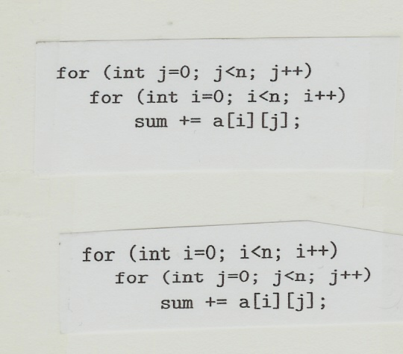
Problem 9
Adding matrix elements
Write and run two C/OpenMP programs for adding elements of a square matrix a.
Implement two versions of loops as shown on this page.
The value of n should be
100 *(number of threads).
Time both codes.
Which of the two versions
runs faster.
Explain why?

